Slide 1

Wavecon telecom Analysis
Presented by :Prajkta Hiwale.

Slide 2
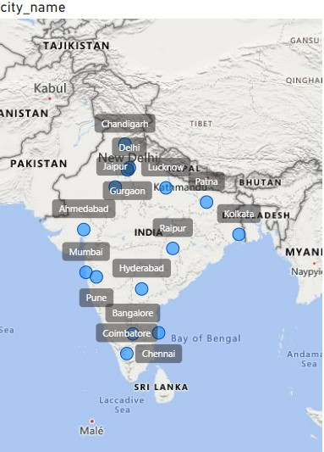
About wavecon telecon
Wavecon is a prominent telecommunication provider in India.
Wavecon operates across 15 major cities in india.
In May 2022, wavecon achieved a significant milestone by introducing its latest 5G services aiming to offer fast and reliable connectivity to customer.

Slide 3
Agenda
Impact of the 5G launch on our revenue
Which KPI is under performing after 5G launch?
Which plan is performing well or not in terms of revenue?
Discontinued after the 5G launch and Reason
Review

Slide 4
Impact of the 5G launch on our revenue

Slide 5
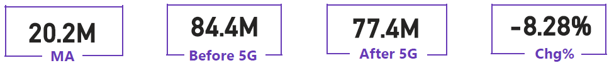
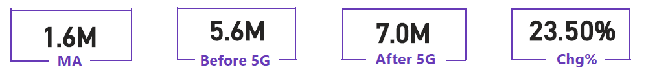
Underperforming after the 5G launch
TAU
TUsU
TAU- Total Active User, TUsU – Total Unsubscribe Users
Insights:
7 million user revenue decline.
The underperforming KPI post 5G launch is TAU which saw a declined from 88.4m to 77.4m
TAU dropped by 8.28% making a significant negative shift in user engagement
TUsU increased by23.50% after the 5G rollout.

Slide 6
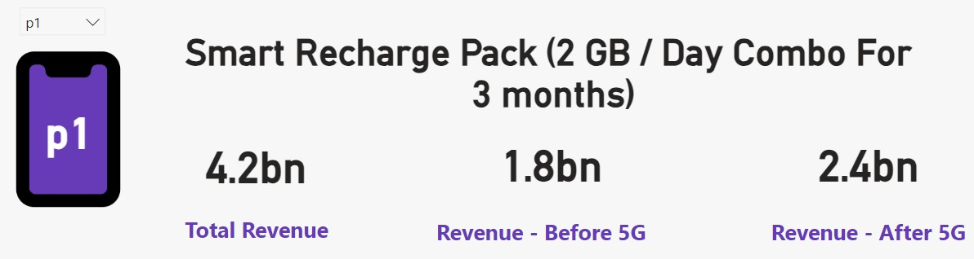
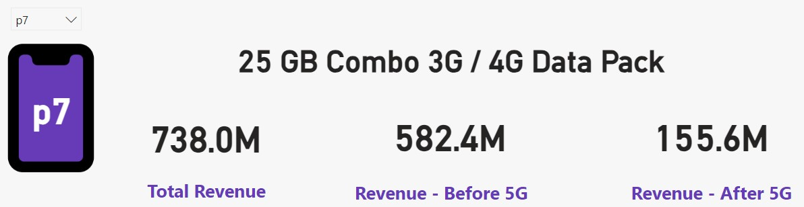
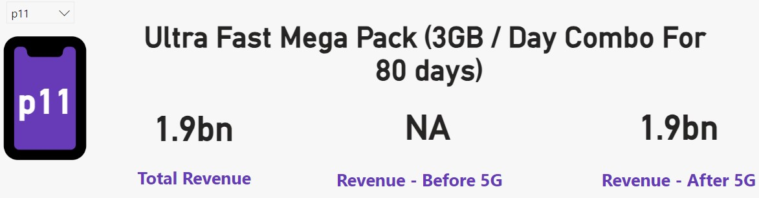
After the 5G launch ,which plans are performing well in terms of revenue ? Which plans are not performing well?
Performing well Not Performing well
Insights:
Plan P1 and P11 shows strong performance. And p11 consistency generate highest revenue.
P7 plan shows lowest revenue compared to all plans.

Slide 7
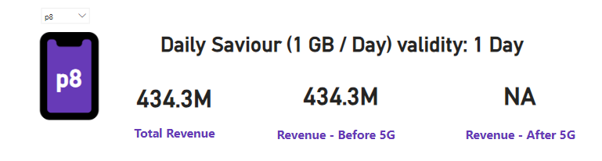
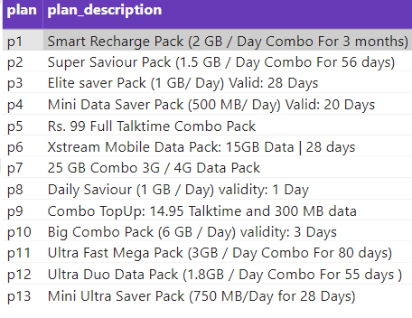
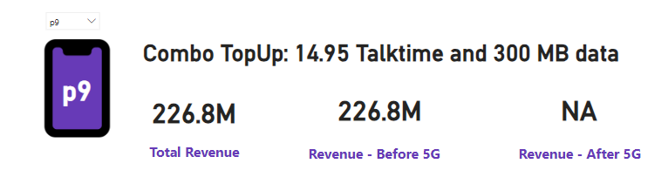
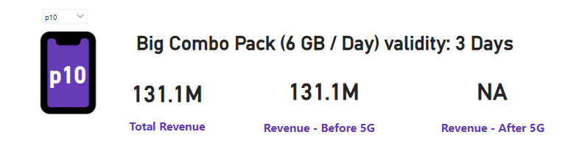
Discontinued after the 5G launch and Reason:
Plan P8 - Daily Saviour (1 GB/Day): Discontinued due to short validity and inadequate data for 5G demands.
Plan P9 - Combo TopUp (14.95 Talktime and 300 MB Data): Discontinued as consumer preference shifted towards plans with more data and talk time.
Plan P10 - Big Combo Pack (6 GB/Day): Discontinued because of its short 3-day validity not meeting customer expectations for flexibility in data usage.

Slide 8
Review
Network improvement: Enhance the 5G network and increase the
Coverage to attract new users, focusing on data needs.
Pricing: Offer transparent and competitive pricing plans to attract and retain customers.
Customer Focus: Enhance customer service and support, resolving issues promptly and gathering feedback.

Slide 9

Thank you

